Slide 1

Telecom Customer Retention
[Prateek Pulkit ]

Slide 2

PROBLEM STATEMENT
Telecom companies lose money when customers leave (churn), and it’s cheaper to keep them than find new ones. This project uses machine learning to predict which customers might churn by looking at their data—like age, usage, bills, and support calls.
Goals:
Predict who’s likely to leave.
Figure out why they’re leaving.
Suggest ways to keep them, like special offers.

Slide 3
Project Description This project is all about helping a telecom company keep its customers from jumping ship (aka churn). We’re using a dataset called telecom_chrn.csv, packed with info about customers—like their age, services they use, bills, and contract details—to figure out who’s likely to leave. The dataset has 21 columns, with 'Churn' being the key one we’re predicting (Yes or No).

Slide 4
Here’s what we did: Data Prep: We loaded the data with Python tools (Pandas, NumPy, Matplotlib, Seaborn) to clean it up, turn text into numbers, and get everything ready for modeling. Picking the Right Clues: We trimmed away less helpful features (like 'Partner', 'PhoneService', 'OnlineBackup', 'TechSupport', 'OnlineSecurity') to make our model sharper. Building the Model: We used a powerful XGBoost classifier (a fancy machine learning tool) and tweaked it (settings like learning rate=0.1, max_depth=5) to predict churn. We tested it thoroughly to make sure it’s reliable. Results: After some fine-tuning, our third model nailed it with 80.36% accuracy and a solid AUC score of 0.844985, meaning it’s pretty good at spotting who might leave. Goal: Help the telecom company understand why customers churn and take action—like offering sweet deals or better support—to keep them around.

Slide 5

WHO ARE THE END USERS?
Customer Retention Teams: Staff responsible for designing and implementing strategies to
keep customers, such as offering personalized promotions or improving service quality based
on the model’s predictions.
Marketing Teams: Professionals who use insights from the model to target at-risk customers
With tailored campaigns or loyalty programs.
Customer Support Teams: Agents who can prioritize outreach or enhanced support to
customers flagged as likely to churn.
Business Analysts and Data Scientists: Teams who interpret the model’s results, refine
it over time, and provide actionable insights to improve retention strategies.
Management/Executives: Decision-makers who use the model’s outputs to allocate resources,
set retention goals, and measure the impact on customer loyalty and profitability.

Slide 6

Technology Used
Programming Language: Python, used for data processing, analysis, and
model development.
Libraries:
Pandas: For loading, manipulating, and exploring the dataset (telecom_chrn.csv).
NumPy: For numerical computations and data handling.
Matplotlib and Seaborn: For data visualization, such as plotting distributions or
correlations to understand customer data.
Missingno: For analyzing and visualizing missing data in the dataset.
Scikit-learn:
Preprocessing: StandardScaler for feature scaling.
Model Selection: train_test_split for splitting data into training and testing sets, and
GridSearchCV for hyperparameter tuning.
Metrics: For evaluating model performance (e.g., accuracy, AUC-ROC).
Development Environment: Jupyter Notebook (Telecom_Churn_Case_Study.ipynb),
run in a Google Colab environment, as indicated by the notebook metadata.
Data Source: A CSV file (telecom_chrn.csv) containing customer data with 21 features,
including demographics, service usage, and billing information.

Slide 7
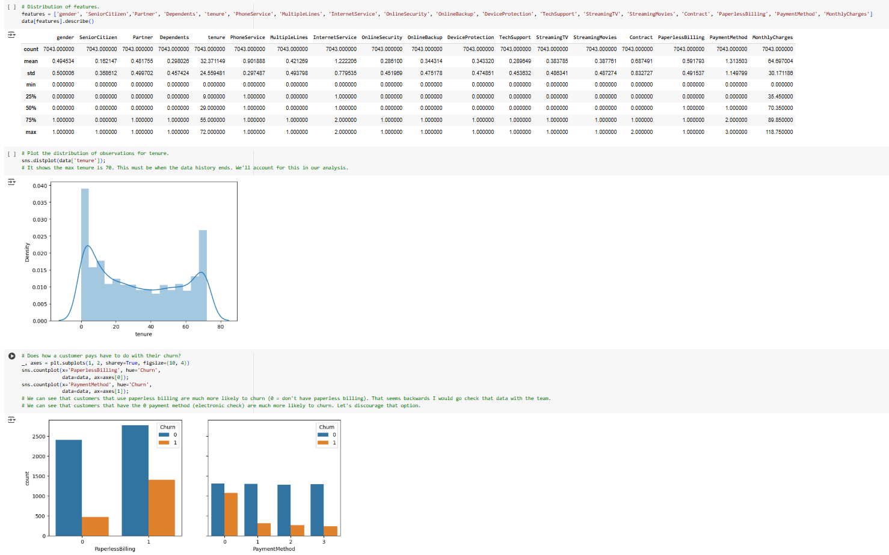
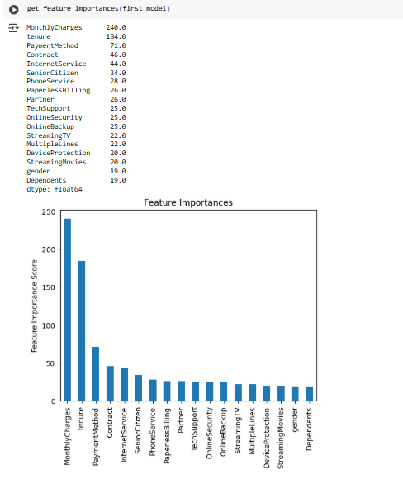
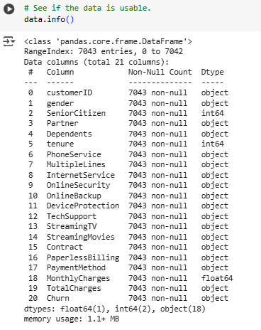
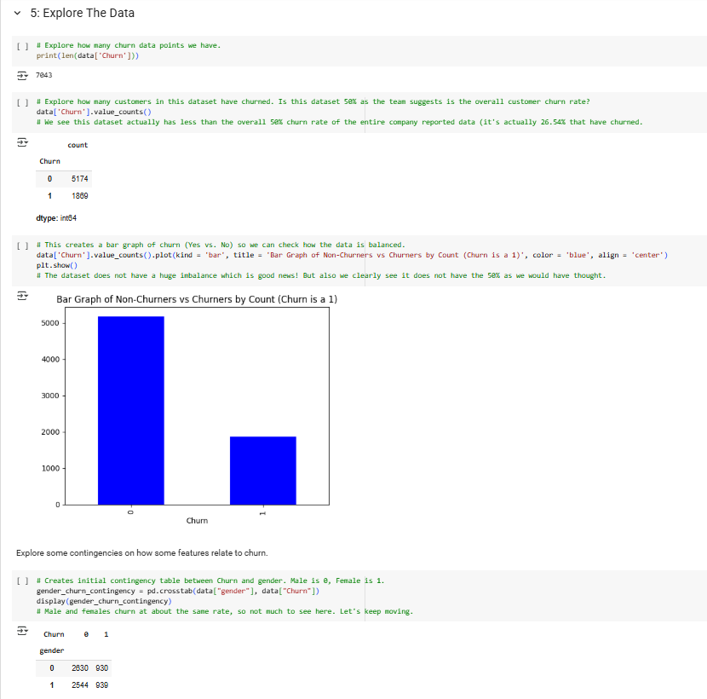
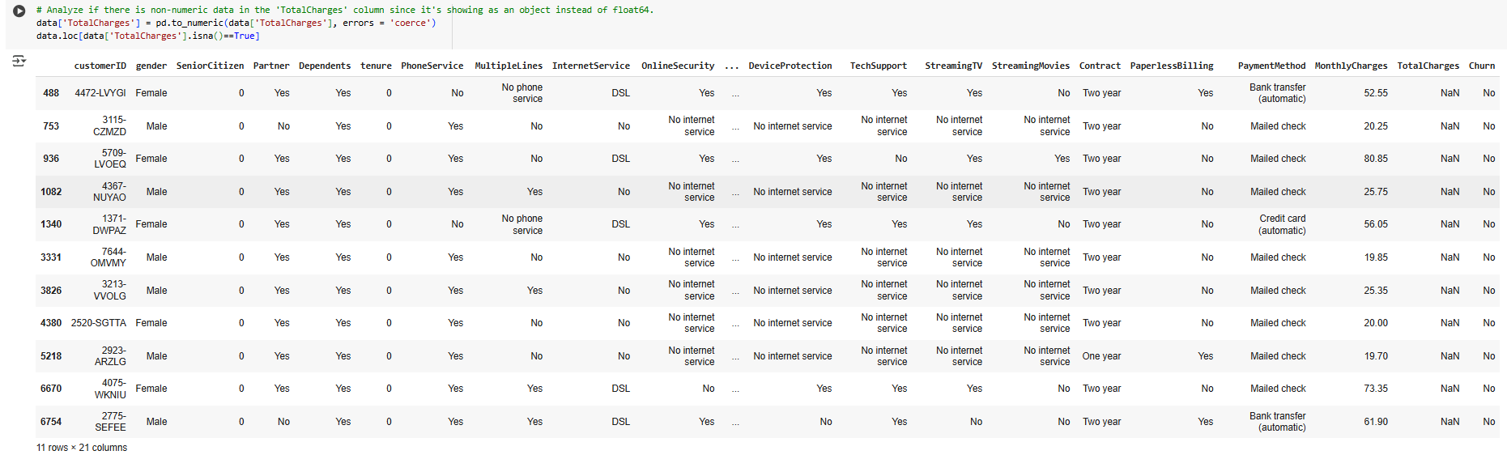
RESULTS

Slide 8
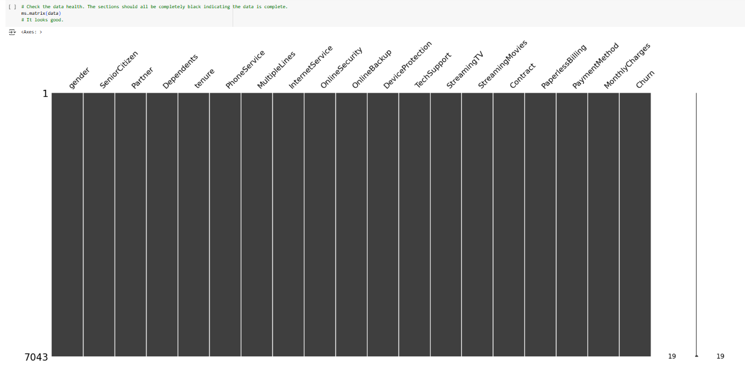
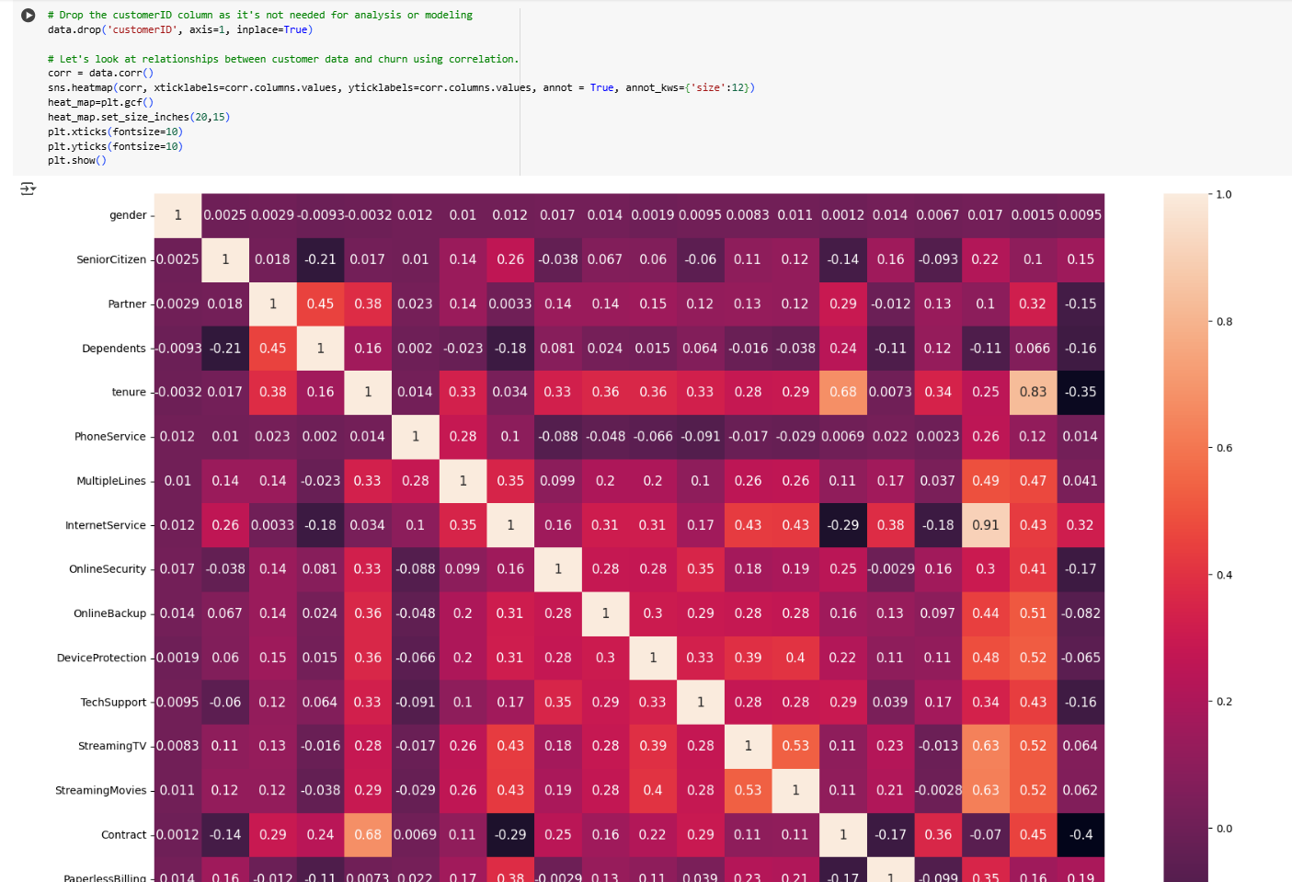
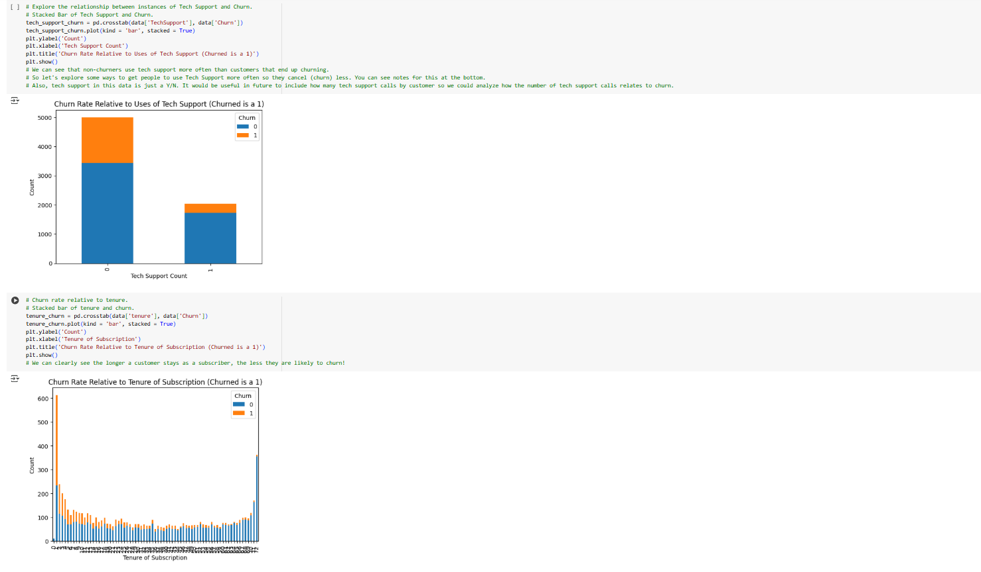
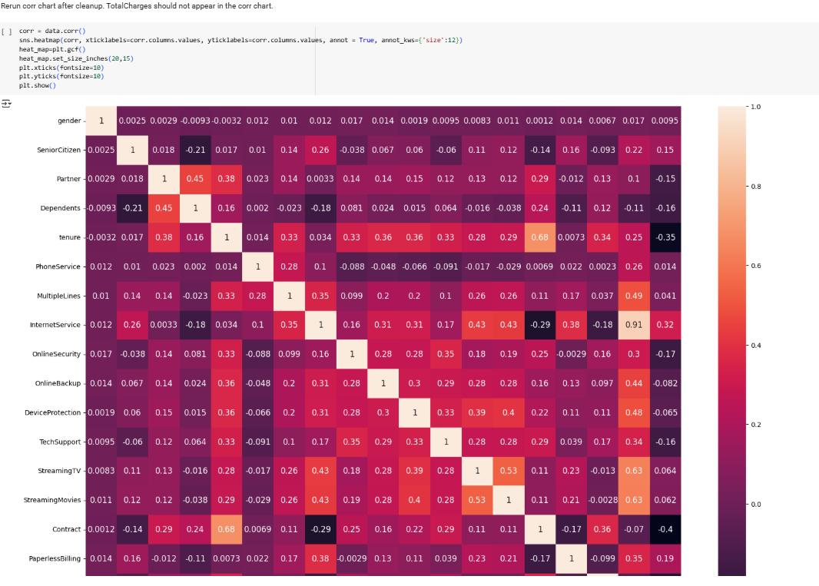
RESULTS
Demo Link

Slide 9
Thank you
.
.
Demo Link

